Slide 1

Capstone project
“Skin Care Product Recommendation System”
Misbah Yasmin
Presented By:

Slide 2
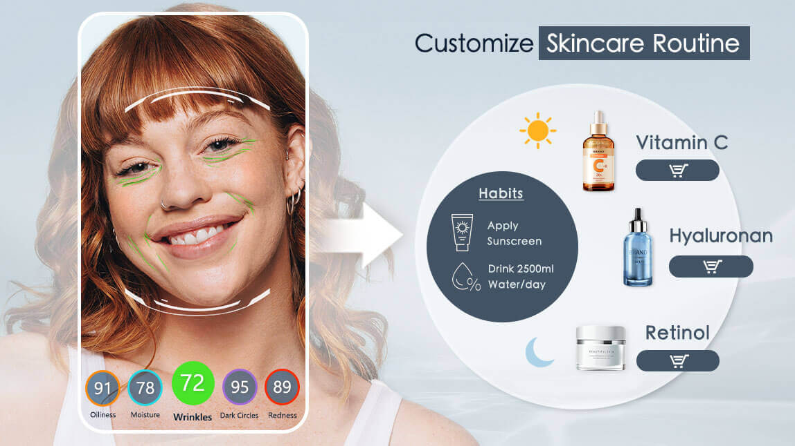
Introduction
People have different skin types and concerns (oily, dry, acne, sensitive, etc.).
Choosing the right skincare product is confusing and expensive.
Our system uses AI and ML to suggest the best skincare products based on individual needs.

Slide 3
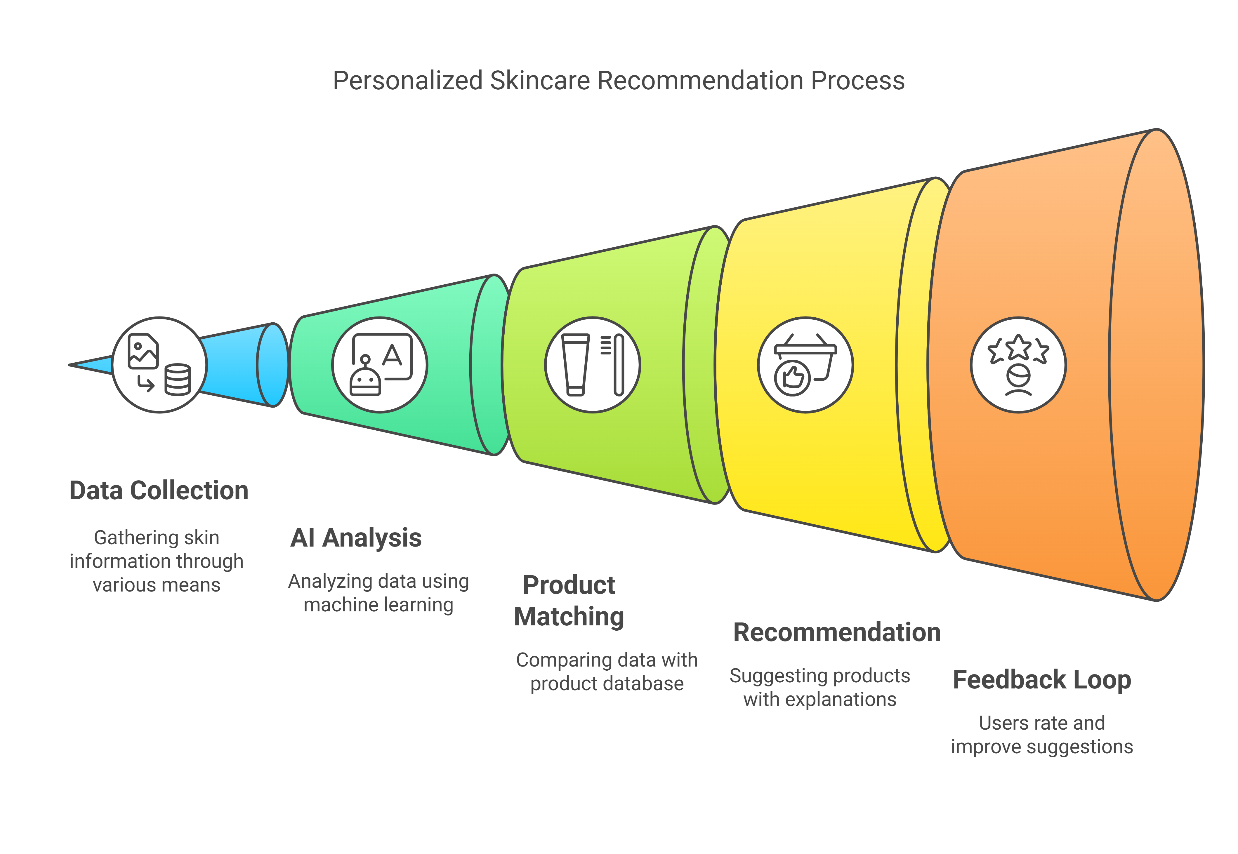
How It Works: Skin Care Recommendation System

Slide 4
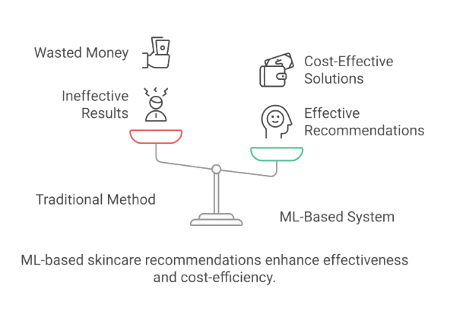
Traditional Method vs. ML-Based Skincare System
Traditional Method:
Leads to wasted money on ineffective products.
Results in ineffective skincare recommendations that may not suit individual needs.
ML-Based System:
Provides cost-effective solutions by analyzing skin type and needs.
Ensures effective recommendations based on data-driven insights.

Slide 5
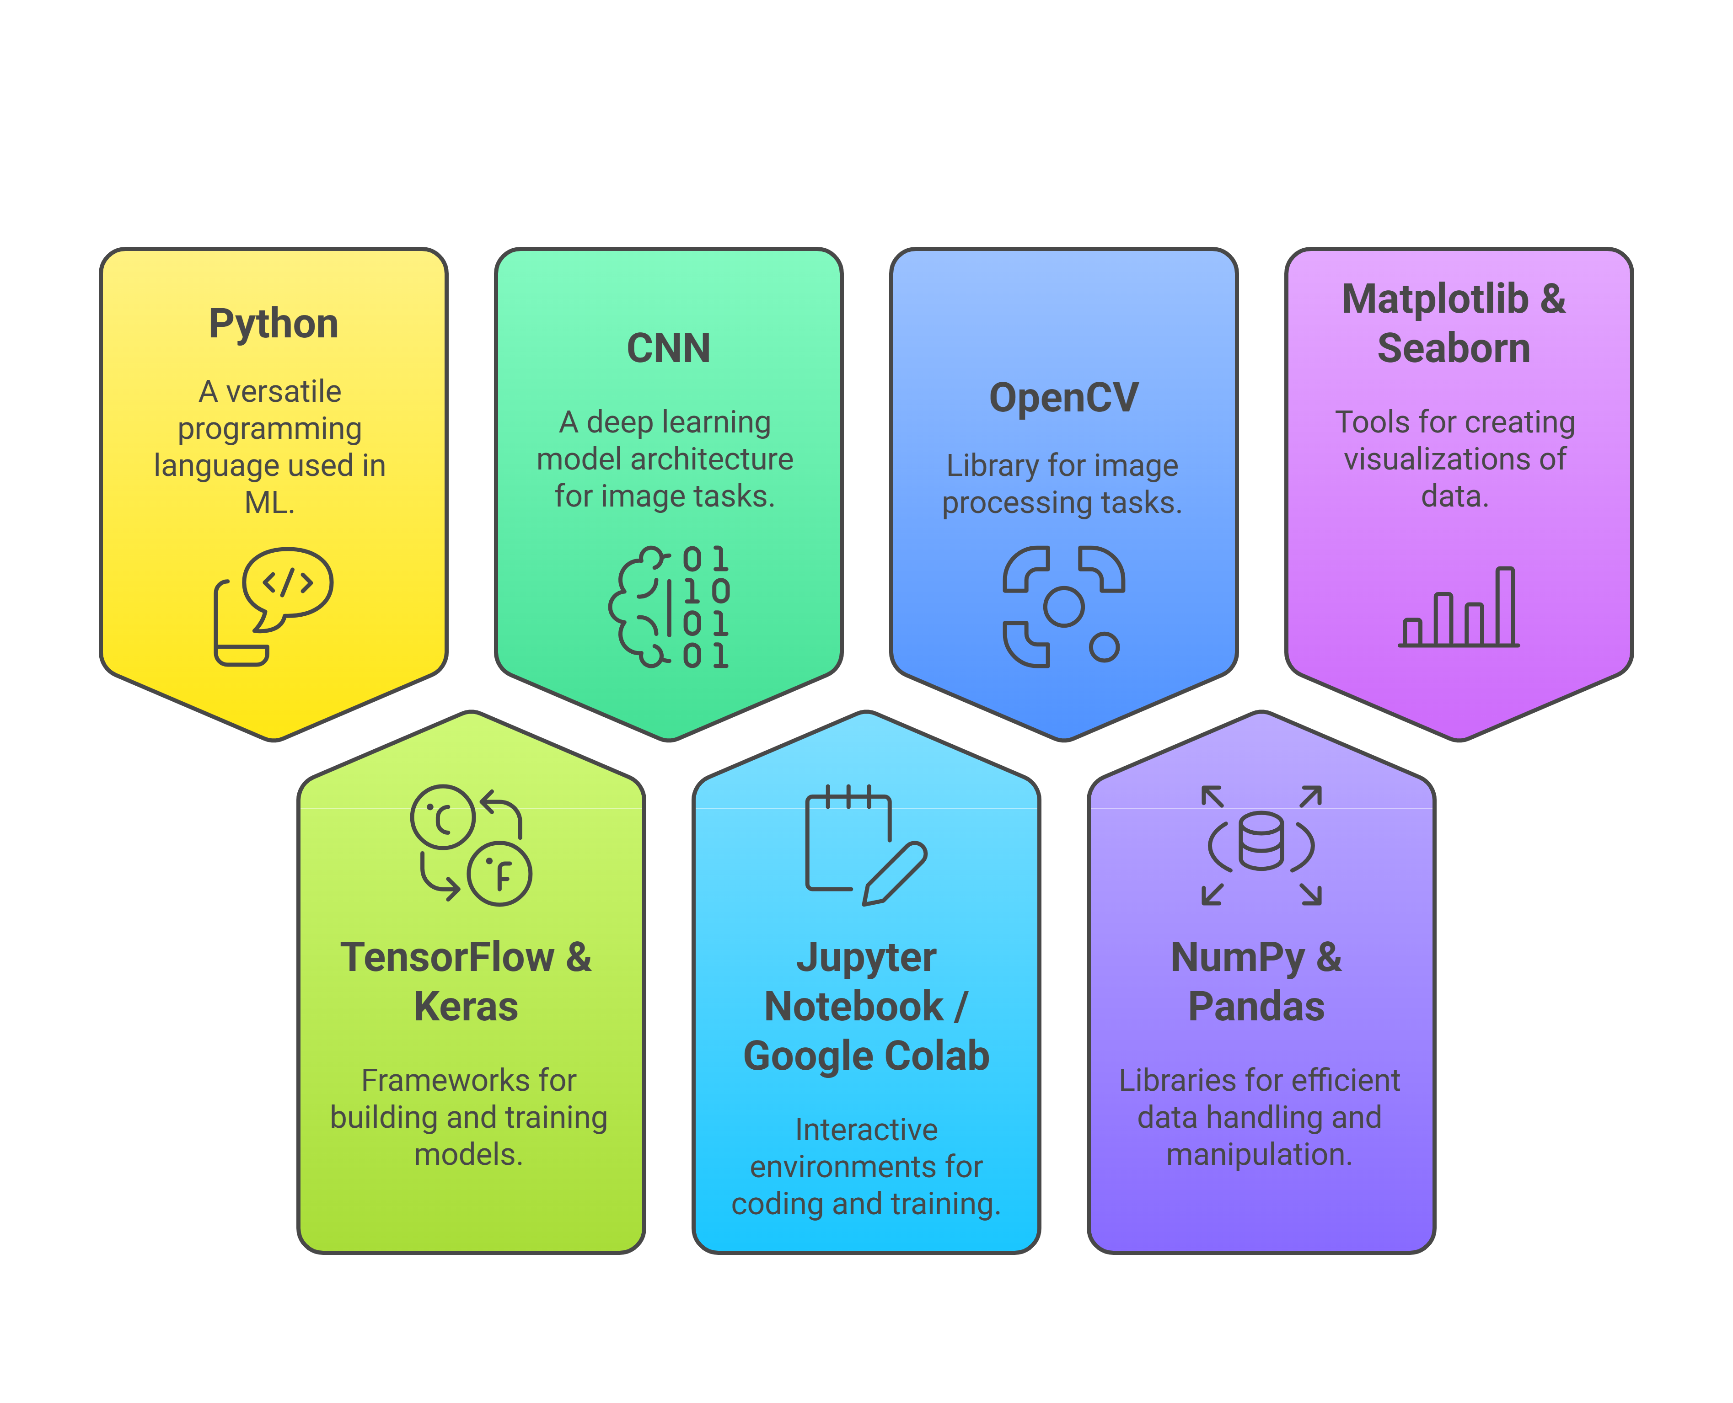
Technologies And Libraries Used:

Slide 6
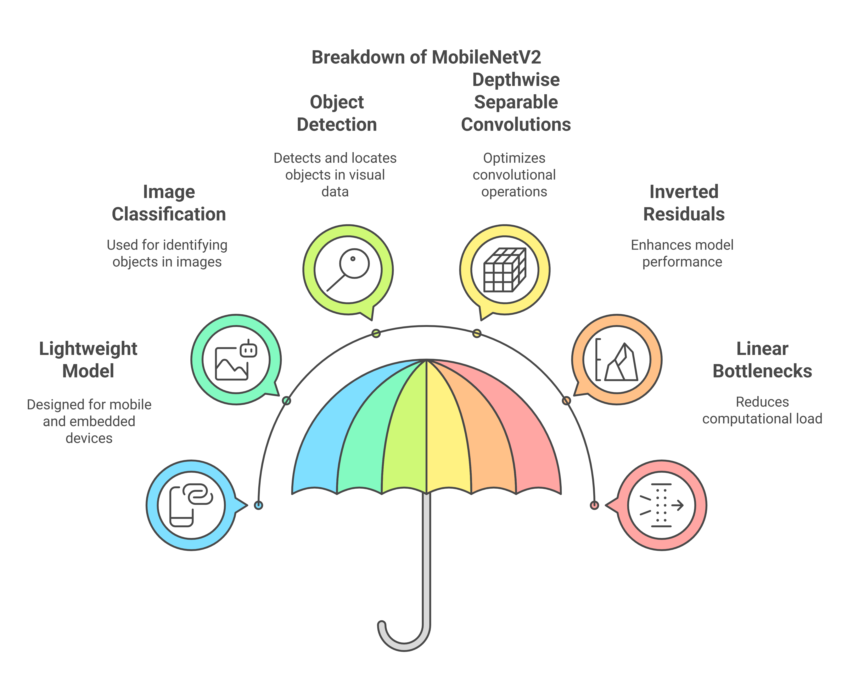
Modal: MobileNetV2

Slide 7
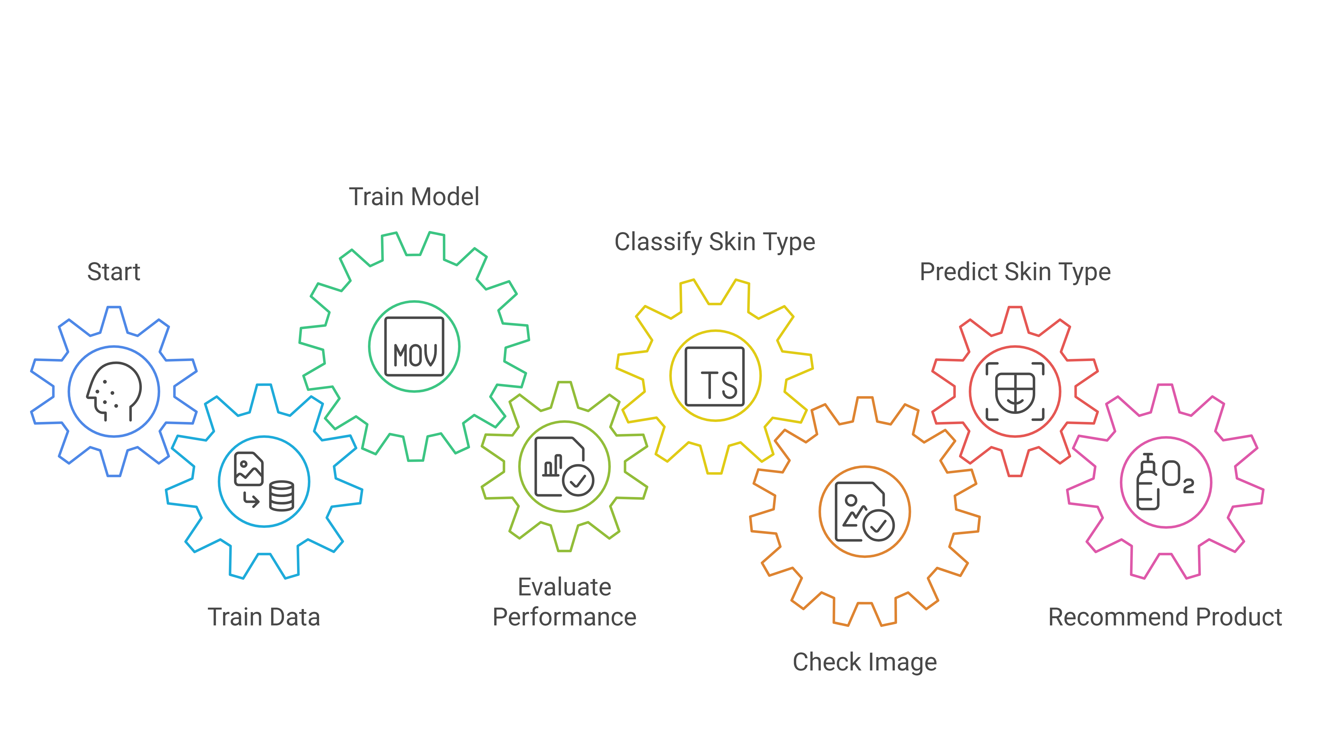
How Algorithm works:

Slide 8
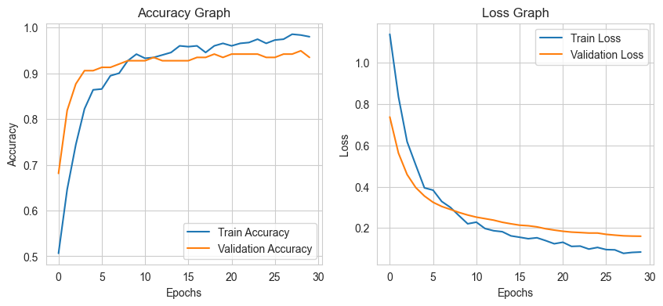
Modal Accuracy and Loss Graph: MobileNetV2

Slide 9
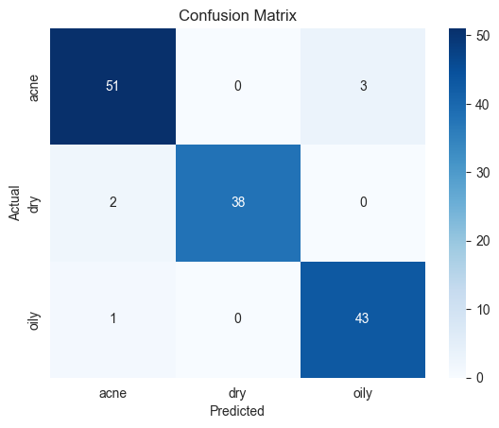
Confusion Matrix: MobileNetV2
Evaluates AI performance in skin type prediction.
Rows: Actual skin types (Acne, Dry, Oily).
Columns: Predicted skin types.
Correct Predictions: 51 Acne, 38 Dry, 43 Oily (Diagonal values).
Misclassifications: Few errors (e.g., 3 Acne → Oily).
High Accuracy: Most predictions are correct.

Slide 10
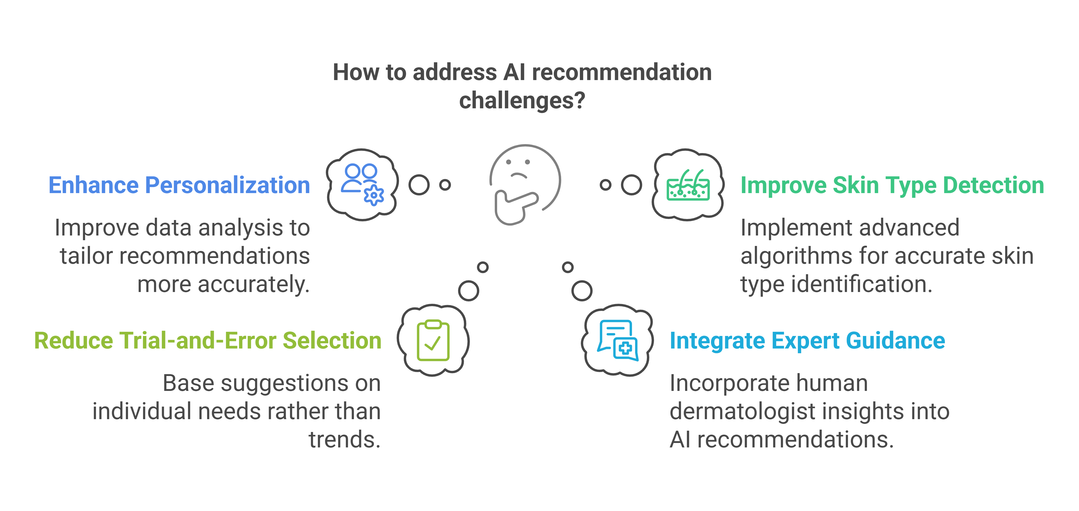
Problems And Challenges:

Slide 11
AI-Powered Skin Analysis: From Idea to Income
Process
Gather and preprocess skin images for training CNN models.
Target
Grow revenue with free plans, paid subscriptions, API sales, and partnerships.
01
03
05
02
04
Business
Identify the target market (dermatologists, skincare brands, e-commerce).
People
Create a user-friendly interface to attract customers.
Profit
License AI to brands & e-commerce for long-term earnings.

Slide 12
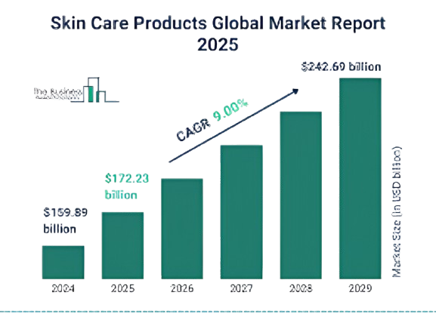
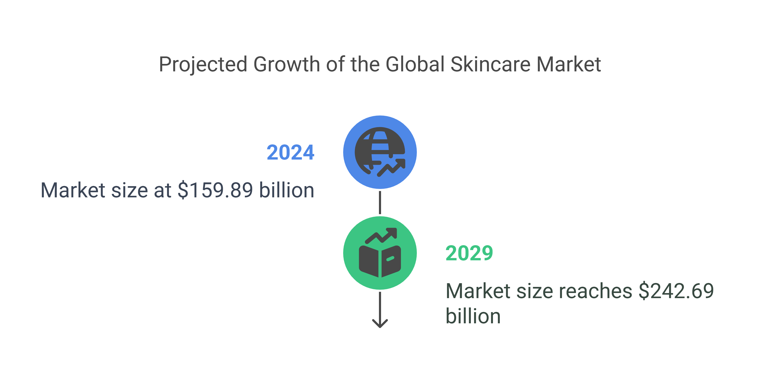
Future market Value:
More demand = more opportunities for AI-powered skincare solutions!
https://www.thebusinessresearchcompany.com/report/skin-care-products-global-market-report

Slide 13
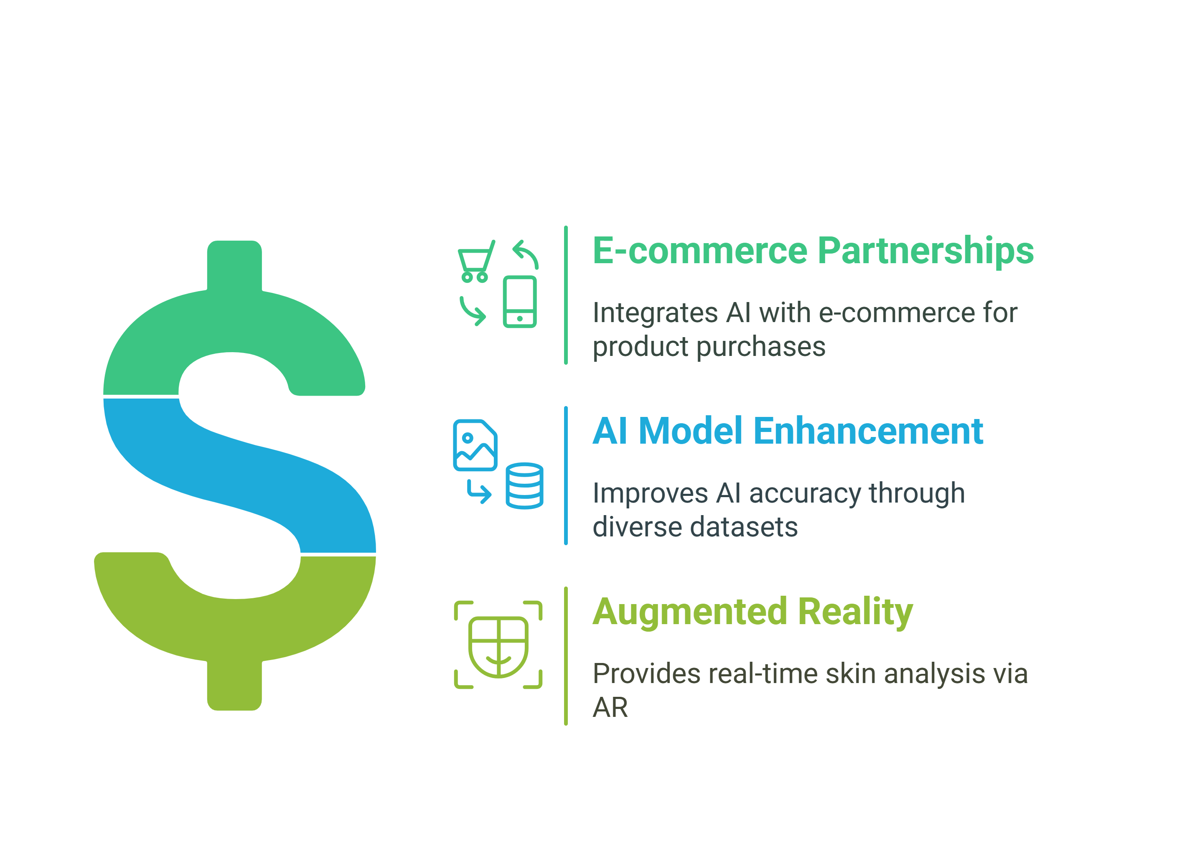
Future Scope

Slide 14
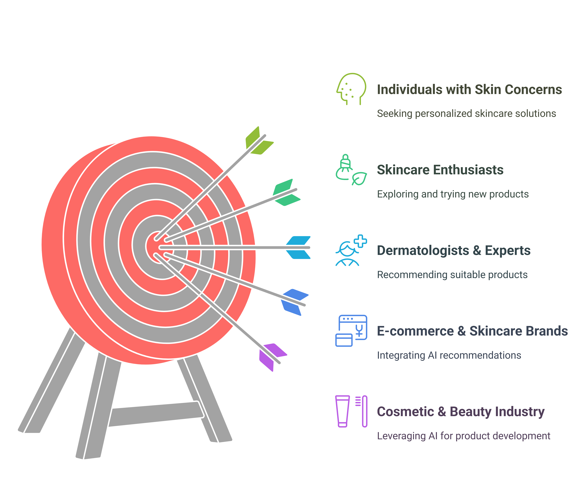
Target Audience:

Slide 15
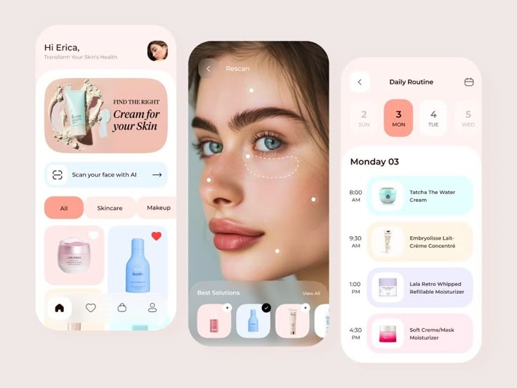
Presenting an app:

Slide 16
Conclusion:
AI improves skincare by eliminating guesswork.
CNN(MobileNetV2) enable accurate skin analysis for personalized recommendations.
Future enhancements include real-time analysis and AR integration.
Bridging technology and skincare for reliable solutions.

Slide 17
Thank you!
Do you have any questions?

